Slide 1
Lesson Three: Properties of Matrix Operations

Slide 2
In this lesson, we will cover
Transpose of a matrix
Properties of matrix operation
We have introduced the transpose of a matrix earlier in previous lessons.
The definition is given, followed by a number of properties.
We then look at the properties of matrix operations e.g. additive commutativity, multiplicative associativity and distributive laws etc.
Each concept is illustrated by several examples

Slide 3
Recall:
The transpose of the matrix A is matrix B =A^{T} , such that b_{ij} = a _{ji}
i.e. the rows become columns and vice versa.

Slide 4
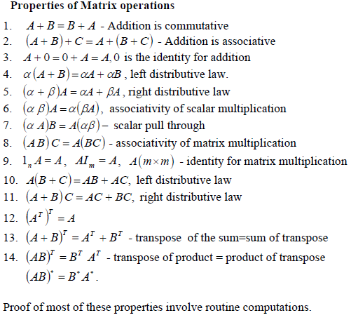
(α A)B=A(αB)

Slide 5
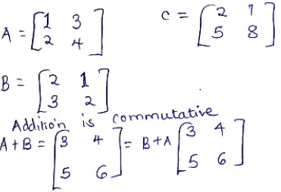
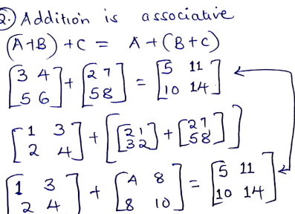

Slide 6
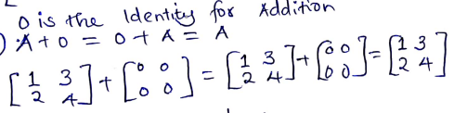
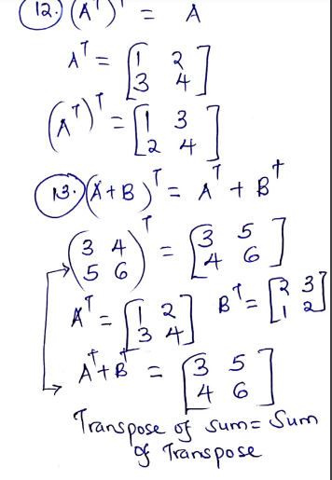

Slide 7
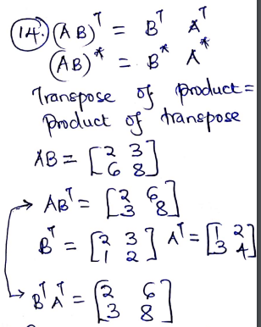

Slide 8
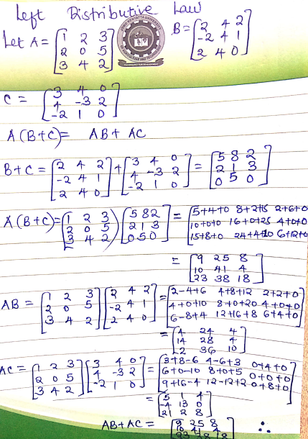

Slide 9
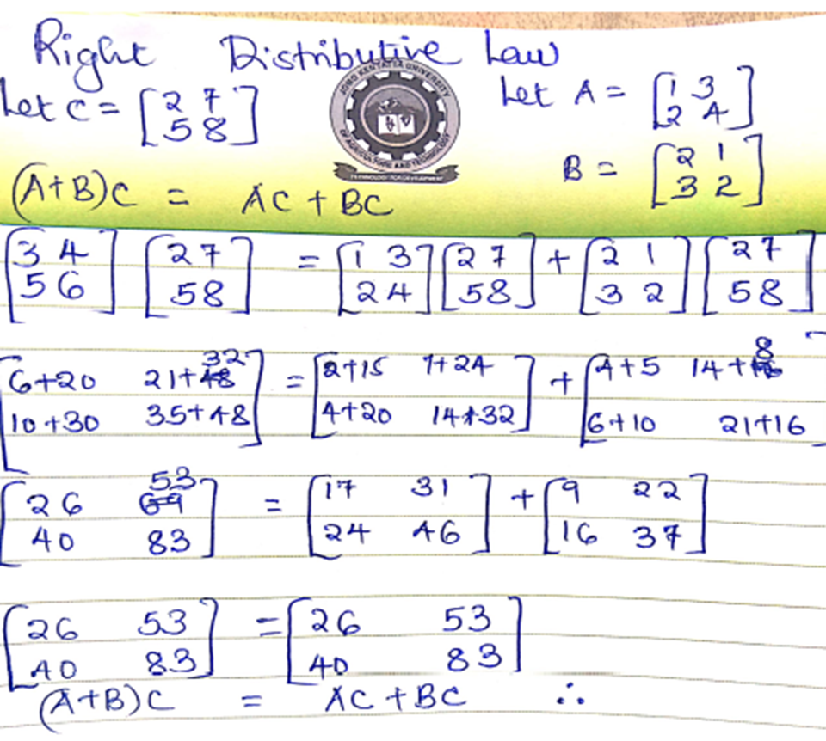

Slide 10
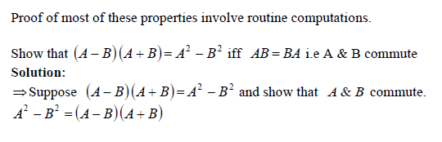
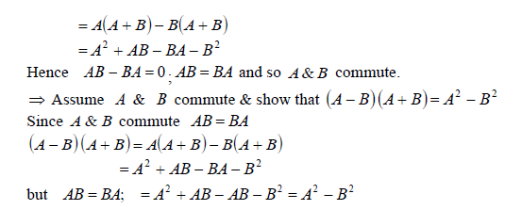

Slide 11
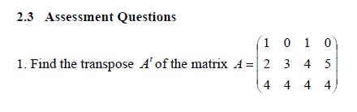

Slide 12
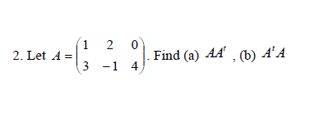

Slide 13
3. Using suitable 3 X3 matrices, verify the left distributive property A(B+C)=AB+AC

Slide 14
Questions? Comments?

